Slide 1
Au’15 select topics
By: Matt Boggus

Slide 2
List o’ stuff
Game genres
Party minigames
Arena first person shooter
3D platformer/puzzler
Horror
Game technology topics
Shaders/graphics
Procedural Content
Physics
Sound
Illumination
AI
Networking
Automatic evaluation of games

Slide 3
Game genres

Slide 4
Party mini-games
Exemplar games: Mario Party, Fusion Frenzy, Rayman Raving Rabbids, WarioWare
Common technical elements and challenges
Transitioning to different game states
Lots of simple gameplay logic scripting (ai players may greatly increase this)
Deep menus or game logic for choosing/computing which mini-game is next
Handling multiple input devices simultaneously
Camera and rendering options for splitscreen
Character animation

Slide 5
Party mini-games links
Designing RPG Mini-Games (and Getting Them Right)
Mini-Games and the Compartmentalizing of Design

Slide 6
Arena first person shooter
Exemplar games: Doom, Quake, Unreal Tournament, TimeSplitters
Common technical elements and challenges
Collision detection (object intersection, raycasting)
Physics (choosing movement speed(s), interactive objects)
Level design and balancing
If extra large levels are desired, level of detail techniques
Scripting weapons
Input remapping and sensitivity levels
Enemy AI – tactics, difficulty/skill
Character animation

Slide 7
Arena first person shooter links
Quake post mortem 1997
Unreal Tournament 3 post mortem 2008
Secrets of the Sages: Level Design
The Visual Guide to Multiplayer Level Design

Slide 8
3D platformer/puzzler
Exemplar games: Mario 64, The Legend of Zelda, Okami, Darksiders
Common technical elements and challenges
Wider variety of character animation required if they interact with objects
Environment design
Puzzle design
Player and camera controls
Player and object physics

Slide 9
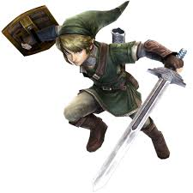
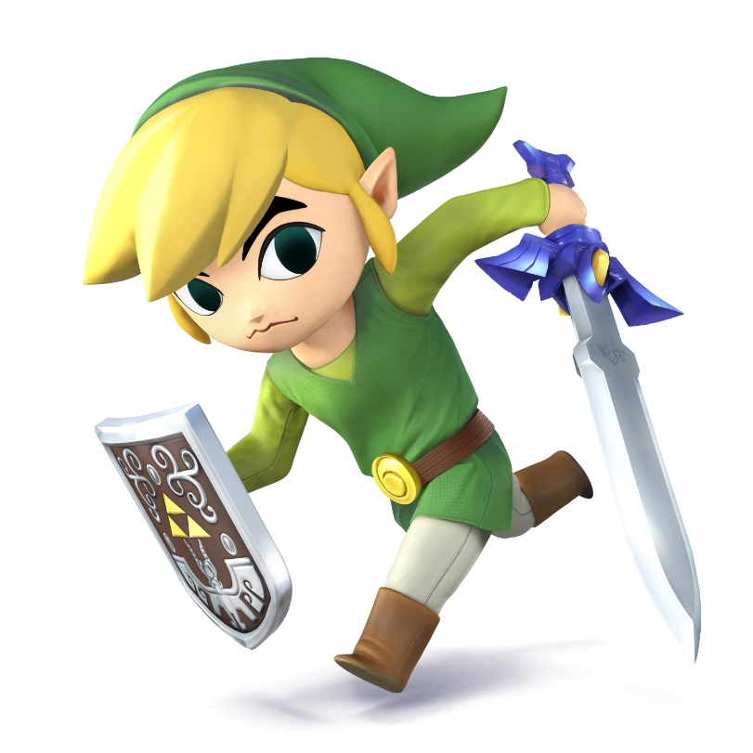
3D platformer/puzzler links

Slide 10
3D platformer/puzzler links
Okamiden post mortem 2011
Procedural generation of Sokoban puzzles
What Legend of Zelda Can Teach Us about Dungeon Design
Video: Designing puzzles that make players feel smart
Video: Game Maker's Toolkit - Super Mario 3D World's 4 Step Level Design

Slide 11
Horror
Exemplar games: Silent Hill, Amnesia: the Dark Descent, Eternal Darkness, parts of the Thief series
Common technical elements and challenges
Environment and level design
Physics if there are objects to interact with
AI (may or may not be aggressive against the player)
Sound design and special effects
Graphics design and special effects
Puzzle design

Slide 12
Horror links
Game Design Deep Dive: Amnesia's 'Sanity Meter‘
http://silenthillheaven.com/shsm/shsm_postmortem/
http://www.gamasutra.com/view/feature/131762/postmortem_thief_the_dark_project.php
http://gamasutra.com/blogs/KoenDeetman/20141111/229864/Horror_Game_Design_Can_Be_Scary.php
http://www.gamasutra.com/view/news/126963/Opinion_How_To_Make_A_Scary_Game.php
http://horror.dreamdawn.com/?p=202230
http://tay.kinja.com/what-makes-the-perfect-horror-game-1619847904

Slide 13
Additional miscellaneous links
http://www.gdcvault.com/
http://gamedevelopment.tutsplus.com/articles/15-analyses-post-mortems-and-game-design-docs--gamedev-11554
http://www.gamasutra.com/view/news/238773/10_seminal_game_postmortems_every_developer_should_read.php
http://www.pixelprospector.com/the-big-list-of-postmortems/
http://level-design.org/

Slide 14
Game technology topics

Slide 15
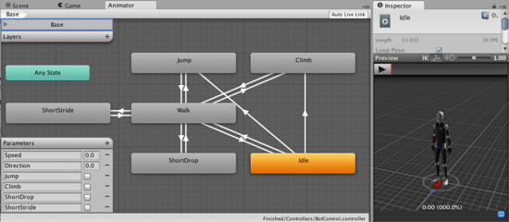
Aside on character animation
http://docs.unity3d.com/432/Documentation/Manual/MecanimAnimationSystem.html

Slide 16
AI technology topics
Unsuitable
Point A to point B pathfinding (ex: A*)
State machines
Search algorithms
Suitable
Use cases / genre specific AI / case studies from commercial games
Fuzzy logic
Advanced pathfinding (dynamic environments, multiple goals or agents)
Machine learning / changing behavior during run-time
Emulating human game playing behavior

Slide 17
Physics
Unsuitable
Rigid body dynamics
Suitable
Specific use cases / case studies from commercial games
Cloth, object destruction or deformation, ragdolls, cartoon physics, fluids
History and evaluation of the use of physics in games
Tutorial on a specific physics engine (Unity v5.0 uses Nvidia's PhysX v3.3)

Slide 18
Automated game evaluation
Locating or creating datasets for analysis
Sales, reviews, marketing, classification (by genre, development team, etc.)
Use cases – evaluate fun (challenge, fantasy, curiosity, …) of
Environments, levels, gameplay mechanics, …
Finding bottlenecks common in game development projects
Game AI Turing Test
Patterns in game design and development
Methods and terminology of playtesting

Slide 19
Procedural content
Procedural
Made automatically (or semi-automatically) instead of entirely by an artist
Content
Textures
Models (terrain, plants, cities, buildings, …)
Level / maps
Distribution of clutter/objects (generation of random samples)
Sound effects and music
Gameplay mechanics and balancing
SP 2015 research course at OSU
Procedural Content Generation Wiki – http://pcg.wikidot.com/
Procedural Content Generation in Games eBook – http://pcgbook.com/

Slide 20
Sound
Procedurally creating sound and music
Evaluating or classifying songs automatically
Composing or sequencing tracks during run-time
Tutorial on specific 3D sound software libraries

Slide 21
Illumination
Common practices, problems, and limitations of illumination in games
Study on the performance limitations of Unity’s lighting implementation
Tutorial on Unity’s lighting features
http://docs.unity3d.com/Manual/LightingOverview.html
Alternative real-time illumination techniques
Global illumination algorithms

Slide 22
Networking
Common practices and problems in networking for games
Latency
Cheating
Streaming
Massively multiplayer games (can include a look at parallel programming)
Tutorial on specific networking libraries or primitive objects for implementing your own

Slide 23
Shaders
Real-time rendering concepts and the graphics pipeline
Example implementations of common rendering effects
Tutorial on
using and modifying pre-made shaders
writing your own shaders

